Slide 1
Retail Mart Management
SQL SCRIPT

Slide 2
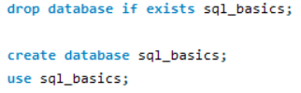
Write a query to create a database named SQL basics.

Slide 3
Write a query to select the database SQL basics.

Slide 4
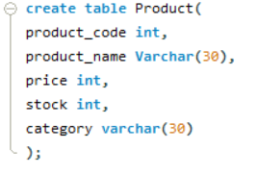
Write a query to create a product table with fields as product code, product name, price, stock and category

Slide 5
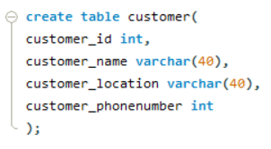
customer table with the fields as customer id, customer name, customer location, and customer phone number

Slide 6
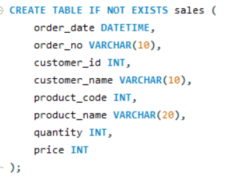
sales table with the fields as date, order number, product code, product name, quantity, and price.

Slide 7
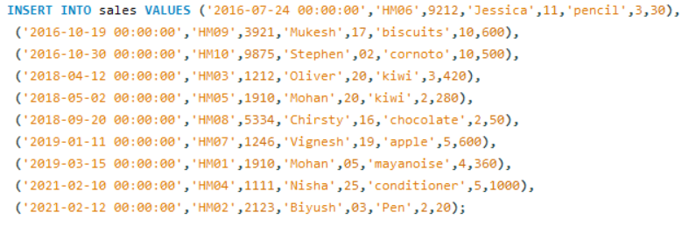
Write a query to insert values into the table sales.

Slide 8
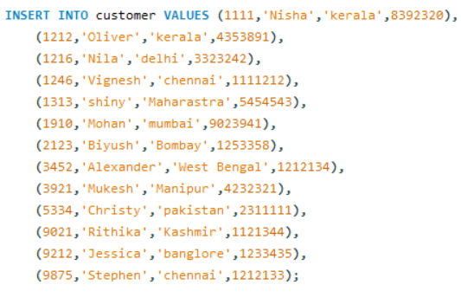
Write a query to insert values into the table customer.

Slide 9
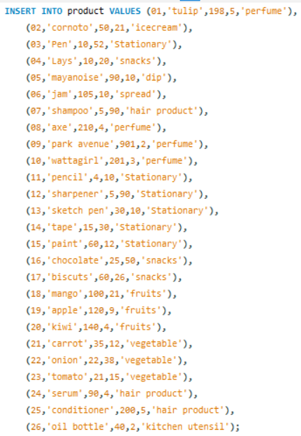
Write a query to insert values into the table product.

Slide 10
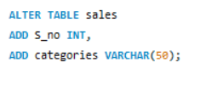
Write a query to add two new columns such as S_no and categories to the sales table.

Slide 11

Write a query to change the column type of stock in the product table to varchar.

Slide 12

Write a query to change the table name from customer-to-customer details.

Slide 13

Write a query to drop the columns S_no and categories from the sales table.

Slide 14

Write a query to display order id, customer id, order date, price, and quantity from the sales table.

Slide 15

Write a query to display all the details in the product table if the category is stationary.

Slide 16

Write a query to display a unique category from the product table.

Slide 17

Write a query to display the sales details if quantity is greater than 2 and price is lesser than 500 from the sales table.

Slide 18

Write a query to display the customer’s name if the name ends with a.

Slide 19
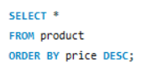
Write a query to display the product details in descending order of the price.

Slide 20
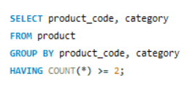
Write a query to display the product code and category from similar categories that are greater than or equal to 2.

Slide 21
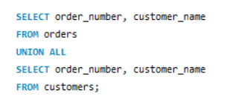
Write a query to display the order number and the customer name to combine the results of the order and the customer tables including duplicate rows.

Slide 22
THANK YOU

